Slide 1
Object-Oriented and
Classical Software Engineering
8th Edition, WCB/McGraw-Hill, 2010
Stephen R. Schach srs@vuse.vanderbilt.edu

Slide 2
CHAPTER 6
TESTING

Slide 3
Overview
Quality issues
Non-execution-based testing
Execution-based testing
What should be tested?
Testing versus correctness proofs
Who should perform execution-based testing?
When testing stops

Slide 4
Testing
There are two basic types of testing
  Execution-based testing
  Non-execution-based testing

Slide 5
Testing (contd)
“V & V”
  Verification
    Determine if the workflow was completed correctly
  Validation
    Determine if the product as a whole satisfies its requirements

Slide 6
Testing (contd)
Warning
  The term “verify” is also used for all non-execution-based testing

Slide 7
Software Quality
Not “excellence”
The extent to which software satisfies its specifications
Every software professional is responsible for ensuring that his or her work is correct
  Quality must be built in from the beginning

Slide 8
Software Quality Assurance
The members of the SQA group must ensure that the developers are doing high-quality work
  At the end of each workflow
  When the product is complete
In addition, quality assurance must be applied to
  The process itself
    Example: Standards

Slide 9
Managerial Independence
There must be managerial independence between
  The development group
  The SQA group
Neither group should have power over the other

Slide 10
Managerial Independence (contd)
More senior management must decide whether to
  Deliver the product on time but with faults, or
  Test further and deliver the product late
The decision must take into account the interests of the client and the development organization

Slide 11
Non-Execution-Based Testing
Underlying principles
  We should not review our own work
  Group synergy

Slide 12
Walkthroughs
A walkthrough team consists of from four to six members
It includes representatives of
  The team responsible for the current workflow
  The team responsible for the next workflow
  The SQA group
The walkthrough is preceded by preparation
  Lists of items
    Items not understood
    Items that appear to be incorrect

Slide 13
Managing Walkthroughs
The walkthrough team is chaired by the SQA representative
In a walkthrough we detect faults, not correct them
  A correction produced by a committee is likely to be of low quality
  The cost of a committee correction is too high
  Not all items flagged are actually incorrect
  A walkthrough should not last longer than 2 hours
  There is no time to correct faults as well

Slide 14
Managing Walkthroughs (contd)
A walkthrough must be document-driven, rather than participant-driven
Verbalization leads to fault finding
A walkthrough should never be used for performance appraisal

Slide 15
Inspections
An inspection has five formal steps
  Overview
  Preparation, aided by statistics of fault types
  Inspection
  Rework
  Follow-up

Slide 16
Inspections (contd)
An inspection team has four members
  Moderator
  A member of the team performing the current workflow
  A member of the team performing the next workflow
  A member of the SQA group
Special roles are played by the
  Moderator
  Reader
  Recorder

Slide 17
Fault Statistics
Faults are recorded by severity
  Example:
    Major or minor
Faults are recorded by fault type
  Examples of design faults:
    Not all specification items have been addressed
    Actual and formal arguments do not correspond

Slide 18
Fault Statistics (contd)
For a given workflow, we compare current fault rates with those of previous products
We take action if there are a disproportionate number of faults in an artifact
  Redesigning from scratch is a good alternative
We carry forward fault statistics to the next workflow
  We may not detect all faults of a particular type in the current inspection

Slide 19
Statistics on Inspections
IBM inspections showed up
  82% of all detected faults (1976)
  70% of all detected faults (1978)
  93% of all detected faults (1986)
Switching system
  90% decrease in the cost of detecting faults (1986)
JPL
  Four major faults, 14 minor faults per 2 hours (1990)
  Savings of $25,000 per inspection
  The number of faults decreased exponentially by phase (1992)

Slide 20
Statistics on Inspections (contd)
Warning
Fault statistics should never be used for performance appraisal
  “Killing the goose that lays the golden eggs”

Slide 21
Comparison of Inspections and Walkthroughs
Walkthrough
  Two-step, informal process
    Preparation
    Analysis
Inspection
  Five-step, formal process
    Overview
    Preparation
    Inspection
    Rework
    Follow-up

Slide 22
Strengths and Weaknesses of Reviews
Reviews can be effective
  Faults are detected early in the process
Reviews are less effective if the process is inadequate
  Large-scale software should consist of smaller, largely independent pieces
  The documentation of the previous workflows has to be complete and available online

Slide 23
Metrics for Inspections
Inspection rate (e.g., design pages inspected per hour)
Fault density (e.g., faults per KLOC inspected)
Fault detection rate (e.g., faults detected per hour)
Fault detection efficiency (e.g., number of major, minor faults detected per hour)

Slide 24
Metrics for Inspections (contd)
Does a 50% increase in the fault detection rate mean that
  Quality has decreased? Or
  The inspection process is more efficient?

Slide 25
Execution-Based Testing
Organizations spend up to 50% of their software budget on testing
  But delivered software is frequently unreliable
Dijkstra (1972)
  “Program testing can be a very effective way to show the presence of bugs, but it is hopelessly inadequate for showing their absence”

Slide 26
What Should Be Tested?
Definition of execution-based testing
  “The process of inferring certain behavioral properties of the product based, in part, on the results of executing the product in a known environment with selected inputs”
This definition has troubling implications

Slide 27
What Should Be Tested? (contd)
“Inference”
  We have a fault report, the source code, and — often — nothing else
“Known environment”
  We never can really know our environment
“Selected inputs”
  Sometimes we cannot provide the inputs we want
  Simulation is needed

Slide 28
What Should Be Tested? (contd)
We need to test correctness (of course), and also
  Utility
  Reliability
  Robustness, and
  Performance

Slide 29
Utility
The extent to which the product meets the user’s needs
  Examples:
    Ease of use
    Useful functions
    Cost effectiveness

Slide 30
Reliability
A measure of the frequency and criticality of failure
  Mean time between failures
  Mean time to repair
  Time (and cost) to repair the results of a failure

Slide 31
Robustness
A function of
  The range of operating conditions
  The possibility of unacceptable results with valid input
  The effect of invalid input

Slide 32
Performance
The extent to which space and time constraints are met
Real-time software is characterized by hard real-time constraints
If data are lost because the system is too slow
  There is no way to recover those data

Slide 33
Correctness
A product is correct if it satisfies its specifications

Slide 34
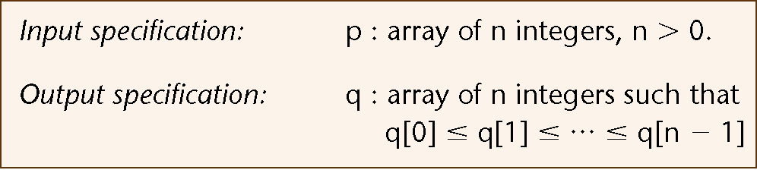
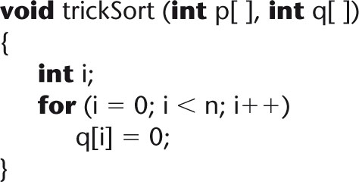
Correctness of specifications
Incorrect specification for a sort:
Function trickSort which satisfies this specification:
Figure 6.1
Figure 6.2

Slide 35
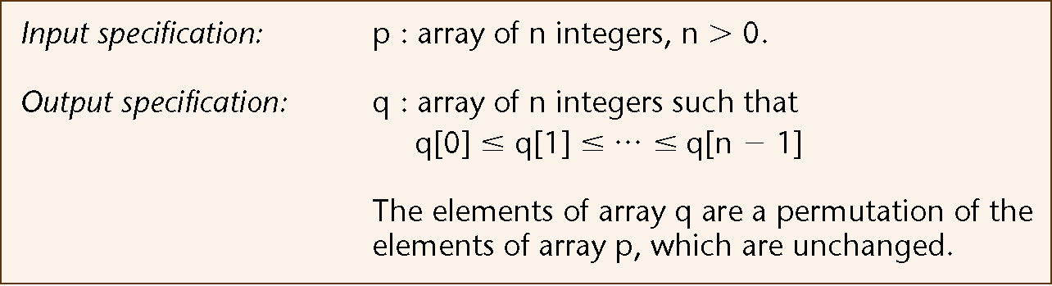
Correctness of specifications (contd)
Incorrect specification for a sort:
Corrected specification for the sort:
Figure 6.1 (again)
Figure 6.3

Slide 36
Correctness (contd)
Technically, correctness is
Not necessary
  Example: C++ compiler
Not sufficient
  Example: trickSort

Slide 37
Testing versus Correctness Proofs
A correctness proof is an alternative to execution-based testing

Slide 38
Correctness Proofs and Software Engineering
Three myths of correctness proving (see over)

Slide 39
Three Myths of Correctness Proving
Software engineers do not have enough mathematics for proofs
  Most computer science majors either know or can learn the mathematics needed for proofs
Proving is too expensive to be practical
  Economic viability is determined from cost–benefit analysis
Proving is too hard
  Many nontrivial products have been successfully proven
  Tools like theorem provers can assist us

Slide 40
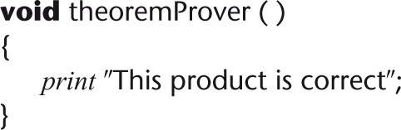
Difficulties with Correctness Proving
Can we trust a theorem prover ?
Figure 6.7

Slide 41
Difficulties with Correctness Proving (contd)
How do we find input–output specifications, loop invariants?
What if the specifications are wrong?
We can never be sure that specifications or a verification system are correct

Slide 42
Correctness Proofs and Software Engineering (contd)
Correctness proofs are a vital software engineering tool, where appropriate:
  When human lives are at stake
  When indicated by cost–benefit analysis
  When the risk of not proving is too great
Also, informal proofs can improve the quality of the product
  Use the assert statement

Slide 43
Who Should Perform Execution-Based Testing?
Programming is constructive
Testing is destructive
  A successful test finds a fault
So, programmers should not test their own code artifacts

Slide 44
Who Should Perform Execution-Based Testing? (contd)
Solution:
  The programmer does informal testing
  The SQA group then does systematic testing
  The programmer debugs the module
All test cases must be
  Planned beforehand, including the expected output, and
  Retained afterwards

Slide 45
When Testing Stops
Only when the product has been irrevocably discarded

